Slide 1






Emergency Management
INTRODUCTION TO CYBER SECURITY
Module 1
2017 JSU GenCyber Teacher Camp
Jacksonville State University

Slide 2
Learning Objectives:
Intro to Cyber Security
Understand and discuss the 10 Cybersecurity Principles;
Gain an understanding of the CIA triad and the CNSS security model;
Acquire a general knowledge of cybersecurity roles and careers.

Slide 3
In this lecture:
Intro to Cyber Security
Section 1: What is Cybersecurity
Section 2: Cybersecurity Implementation Approaches
Section 3: 10 Principles of Cyber Security
Section 4: CIA Triad
Section 5: CNSS Security Model
Section 6: Cybersecurity Roles and Careers
Section 7: Professional Organizations and Certifications

Slide 4



What is Cybersecurity?
Intro to Cyber Security
Cybersecurity is the body of technologies, processes and practices designed to PROTECT networks, computers, programs and data from attack, damage or unauthorized access.
http://www.pixuffle.net/wp-content/uploads/2017/05/Disadvantages-of-computer-network.jpg
www.dell.com
https://komputerupdate.com/wp-content/uploads/2017/05/komputerupdate.com_Mengenal-Apa-Itu-Software-Komputer.png

Slide 5
What is Cybersecurity?
Intro to Cyber Security
The prevention of damage to, unauthorized use of, or exploitation of, and if needed, the restoration of electronic information and communications systems and the information contained therein to ensure confidentiality, integrity, and availability. Includes protection and restoration, when needed, of information networks and wireline, wireless, satellite, public safety answering points, and 911 communications systems and control systems
(National Infrastructure Protection Plan, Dept. of Homeland Security, 2011, p. D-2)

Slide 6
Cybersecurity Implementation Approaches
Intro to Cyber Security
The White House Cybersecurity Strategy & Implementation Plan (CSIP) (2015):
Prioritized Identification and Protection
Timely Detection and Rapid Response
Rapid Recovery and Accelerated Adoption
Recruitment and Retention of the Cybersecurity Workforce
Efficient and Effective Acquisition and Deployment of Existing and Emerging Technology.
Organize the data based on:
Objectives: “What do you need to achieve?”
Goals: “How and Where should you focus your efforts to achieve those objectives.”

Slide 7
10 Principles: #1 Domain Separation
Intro to Cyber Security
Keeping the test data separate from the operational data is an example of domain separation.
Inside a computer system, there are also domains e.g. supervisor domain vs. user domain.

Slide 8
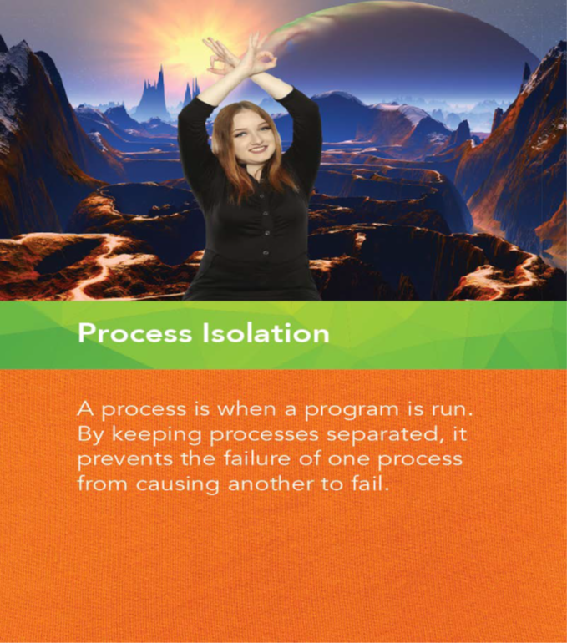
10 Principles: #2 Process Isolation
Intro to Cyber Security
Processes running in a computer have their own portion of memory called the address space.
The address space is an area of memory that only one running program can access.
If a word processor, a database and a browser are running on a computer, they run in different address spaces. This is done to ensure correct operation, security and protection.

Slide 9
10 Principles: #3 Resource Encapsulation
Intro to Cyber Security
Encapsulation is an object oriented concept where all data and functions required to use the resource are packaged into a single self-contained component.
The goal is to only allow access or manipulation of the resource in the way the designer intended.

Slide 10
10 Principles: #4 Least Privilege
Intro to Cyber Security
The principle of least privilege says to allow the minimum number of privileges necessary to accomplish the task.

Slide 11
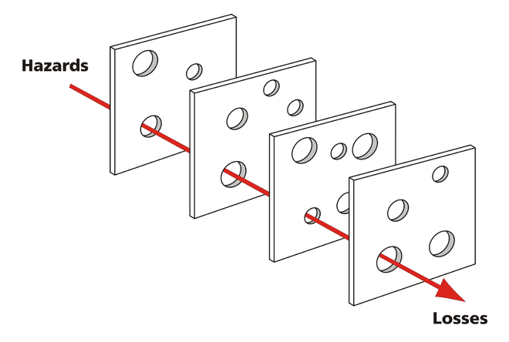
10 Principles: #5 Layering
Intro to Cyber Security
Layered security is an example of the "Swiss Cheese model" used in risk management.
https://en.wikipedia.org/wiki/Swiss_cheese_model

Slide 12
Check for Understanding Q1
http://app.gosoapbox.com
Event code: 288-095-730
One of the ways to protect information is by limiting what people can do with your information and resources. This principle is known as-
Domain Separation
Process Isolation
Least Privilege
Layering

Slide 13
Check for Understanding Q2
http://app.gosoapbox.com
Event code: 288-095-730
True or False: Cyber security uses single layer of defense for protecting information.

Slide 14
10 Principles: #6 Abstraction
Intro to Cyber Security
The goal in abstraction, from a computer security viewpoint is to remove any clutter that can distract and possibly be used in an incorrect way.
Abstraction only provides the essential details of what is being modeled and provide the minimum information necessary to accomplish the task.

Slide 15
10 Principles: #7 Information Hiding
Intro to Cyber Security
Data and information hiding keeps the programmer from having complete access to data structures. It allows access to only what is necessary.

Slide 16
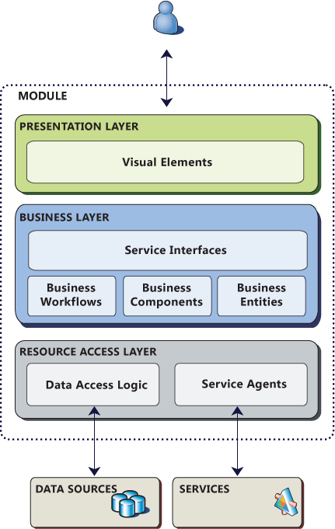
10 Principles: #8 Modularization
Intro to Cyber Security

Slide 17

Check for Understanding Q3
http://app.gosoapbox.com
Event code: 288-095-730
Which principle is represented by the hand signal in the image?
Modularity
Information Hiding
Abstraction
Layering

Slide 18
10 Principles: #9 Simplicity
Intro to Cyber Security
KISS
Keep Information Simply Secured

Slide 19
10 Principles: #10 Minimization
Intro to Cyber Security
As software increases in size, the ability to secure the program becomes more difficult due to the sheer size and increased complexity of the software.

Slide 20
Properties of Information
Intro to Cyber Security
Stored
When the original file remains in storage on the hard drive or cloud
Processed
When the data is being examined or modified or entered into an information system
Transmitted
Occurs when the information is data is being transferred through any medium.

Slide 21
C.I.A. Triad
Intro to Cyber Security
According to Maconachy, Schou, Ragsdale, and Welch (2001):
Confidentiality is “the assurance that information is not disclosed to unauthorized persons, processes or devices”
Integrity is “the quality of an information system reflecting logical correctness and reliability of an operating system; the logical completeness of the hardware and software implementing the protection mechanisms; and the consistency of the data structures and occurrence of the stored data”
Availability is the “timely, reliable access to data and information services for authorized users” (p. 307, cited from NSA National Information System Security Glossary, 2000).

Slide 22
Committee on National Security Standards(CNSS) Model
Intro to Cyber Security
Computer & Data Security
Network Security
Management of Information Security
Components of Information Security
Policy

Slide 23
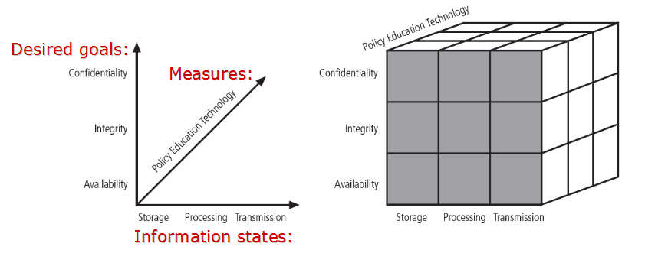
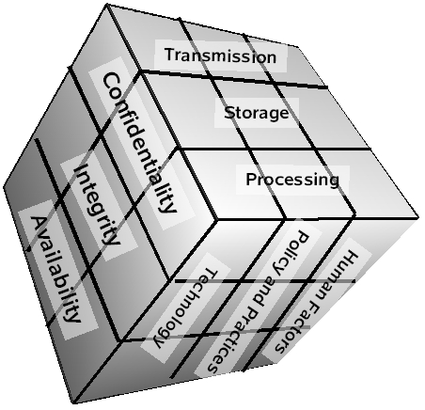
Committee on National Security Standards(CNSS) Model
Intro to Cyber Security
The McCumber Cube
Confidentiality
http://www.aplontech.com/index.php/articles-and-tutorials/it-security/73-cnss-security-model
http://en.wikipedia.org/wiki/McCumber_cube

Slide 24
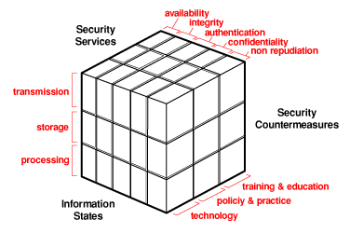
Committee on National Security Standards(CNSS) Model
Intro to Cyber Security
Source: http://www.ibm.com/developerworks/security/library/s-confnotes2/figure4.gif

Slide 25
Check for Understanding Q4
http://app.gosoapbox.com
Event code: 288-095-730
True or False: To develop a secure system, one must consider not only key security goals (CIA), but also how these goals relate to various states in which information resides and full range of available security measures.

Slide 26
Security Roles, Careers, and Professionals
Intro to Cyber Security
Security Roles, Careers, and Professionals (Information Security, 2016):
Incident and Threat Managers, Forensics Experts
Incident and/or Threat Manager
Forensics-computer, mobile and network analyst
Penetration Tester
Business Continuity or Disaster Recovery
Risk Analysts, Risk Managers
Verification and Compliance
Risk Analyst or Assessor
Information Security Officer
Auditor
Policy Makers and Strategists
Information Technology Security Officer
Chief Information Security Officer

Slide 27
Security Roles, Careers, and Professionals
Intro to Cyber Security
Security Roles, Careers, and Professionals (Information Security, 2016):
Operations and Security Management
Network or Systems Security Officer
Information Security Officer or Manager
Engineering, Architecture, and Design
Architect, Designer or Developer
Secure Coding
Software Design and Development
Security Tools
Implementation
Research
Professor
Security Researcher
Education, Training, and Awareness
Security Program Manager

Slide 28
Organizations and Certifications
Intro to Cyber Security
Organizations
(ISC)2: International Information Systems Security Certification Consortium
ISSA: Information Systems Security Association
OWASP: Open Web Application Security Project
ISSA: Information Systems Security Association
FIRST: Forum of Incident Response and Security Teams
Center for Internet Security
ISF: Information Security Forum
National Association of ISACs
Internet Security Alliance
CSA: Cloud Security Alliance
ISFS: Information Security and Forensics Society

Slide 29
Organizations and Certifications
Intro to Cyber Security
Certifications:
Certified Information Systems Security Professional (CISSP),
Certified Information Systems Auditor (CISA),
Certified Information Security Manager (CISM),
GIAC Security Essentials (GSEC),
CompTIA Security +
Certified Wireless Security Professional (CWSP)

Slide 30
Emergency Management
References
Cybersecurity Strategy and Implementation Plan (CSIP) for Federal Civilian Government [Letter to US Federal Government]. The White House, Washington,, DC.
Department of Homeland Security, 1-50. Retrieved May 3, 2017.Donovan, S., & Scott, T. (2015, October 30).
Encyclopedia of United States National Security. doi:10.4135/9781412952446.n397National Initiative for Cybersecurity Careers and Studies (NICCS). (2016). Retrieved May 10, 2017, from https://niccs.us-cert.gov/training/professional-certifications
Maconachy, W. V., Schou, C. D., Ragsdale, D., & Welch, D. (2016, May 4). A Model for Information Assurance: An Integrated Approach. Address presented at Proceedings of the 2001 IEEE Workshop on Information Assurance and Security in United States Military Academy, West Point, NY.
National Security Agency (NSA). (2000).
What are the career paths in the computer security field? (2011, May 12). Retrieved May 10, 2017, from http://security.stackexchange.com/questions/3772/what-are-the-career-paths-in-the-computer-security-field
Whitman, M. E., & Mattord, H. J. (2016). Management of information security (5th ed.). Boston, MA: Cengage.

